Slide 1
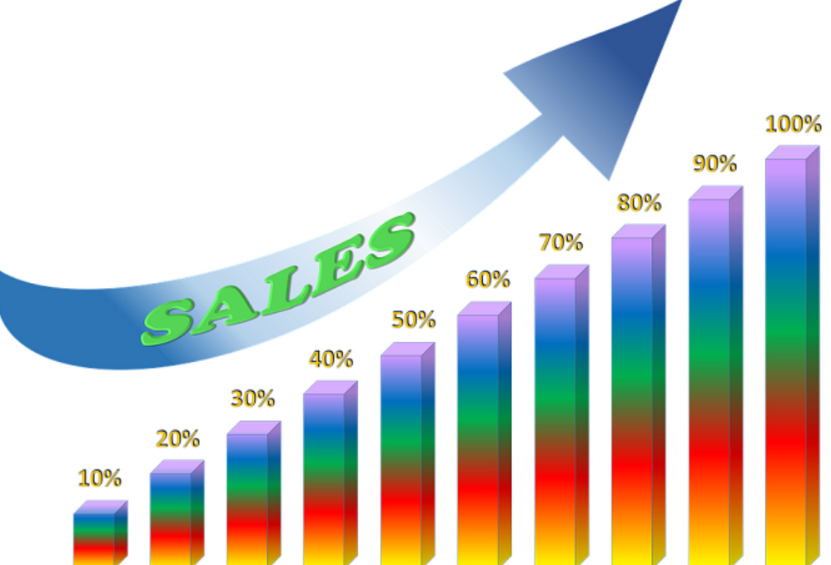
BIG MART SALES PREDICTION USING ML
Div 4: G7 Batch
Team members:
Nrup Patel(20BCP226)
Nirav Patel(20BCP230)
Parshwa Gandhi(20BCP233)
Under guidance of Prof. Chintan Bhatt

Slide 2
INDEX
ABSTRACT
INTRODUCTION
DATASET DESCRIPTION
PROPOSED WORK
CONCLUSION
REFERENCES
RELATED WORK AND LITERATURE SURVEY
METHODOLOGY

Slide 3
ABSTRACT
Our main aim is to create model is to know how all parameter affecting sales And how can we improve sales.
Some of the big stores are not able to know that why their sales are below their expectation our model will help them in this.
For this we firstly did preprocessing in which we removed outliers and fill missing values in dataset.
After that we apply regression to get r square which is giving relationship between target variable and feature variables.
Our project is showing that how a medium sized store can improve sales of items by doing work on different parameters.

Slide 4
INTRODUCTION
“To find out what role certain properties of an item play and how they affect their sales by understanding Big Mart sales.” this is main objective of this model.
A predictive model can be built to find out for every store, the key factors that can increase their sales and what changes could be made to the product or store’s characteristics.
For building this model we use various techniques of machine learning like data preprocessing , feature engineering and find accuracy.

Slide 5
Methodology
  Data preprocessing is an important preliminary step for the data mining process.
  Preprocessing of the dataset includes doing analysis on the independent variables like checking for null values in each column and then replacing or filling them with supported appropriate data types, so that analysis and model fitting is not hindered from its way to accuracy.
  Feature engineering is the process of selecting, manipulating, and transforming raw data into features that can be used in supervised learning.

Slide 6
Methodology
Regression can be termed as a parametric technique which is used to predict a continuous or dependent variable on basis of a provided set of independent variables.
Regression models the target predictive value based on the independent variables. It is mostly used for finding the relationship between variables and forecasting.
Random forest algorithm is a very accurate algorithm to be used for predicting sales.
In sales prediction, random forest classifier is used because it has decision tree like hyperparameters.

Slide 7
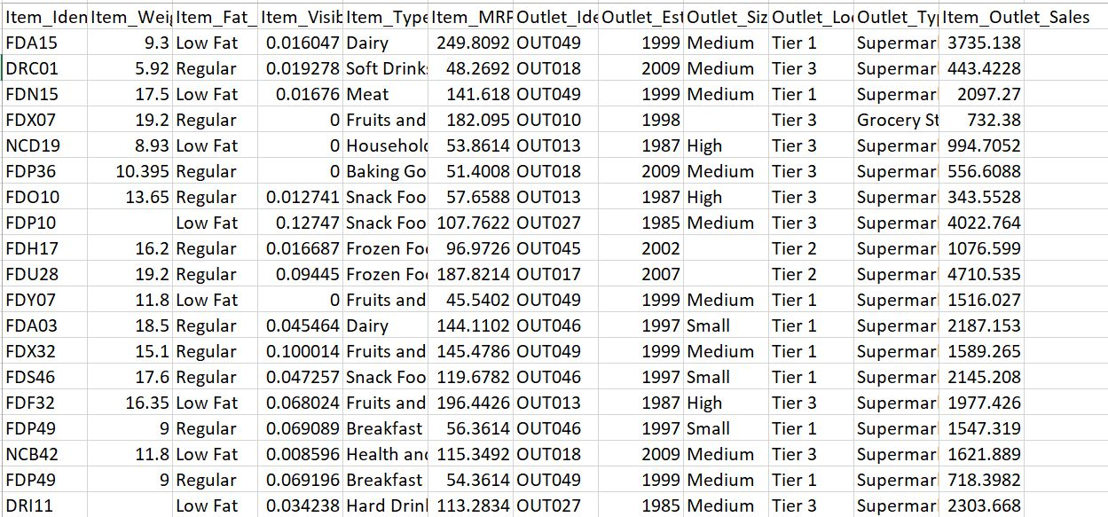
DATASET
DESCRIPTION
The data scientists at BigMart have collected 2013 sales data for 1559 products across 10 stores in different cities.
This dataset consists 12 features and 8522 records

Slide 8
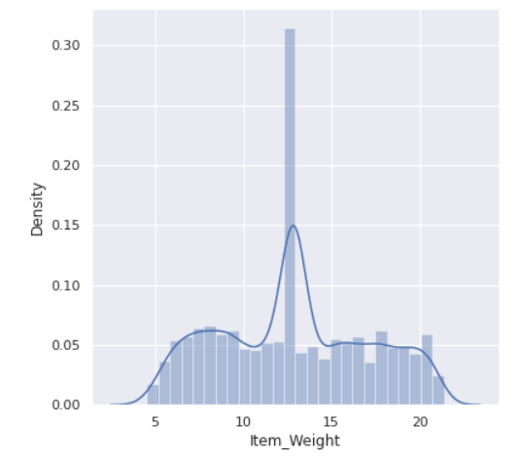
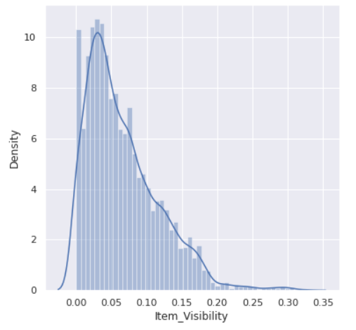
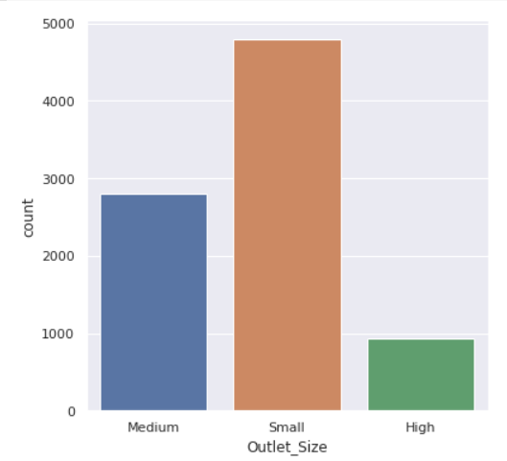
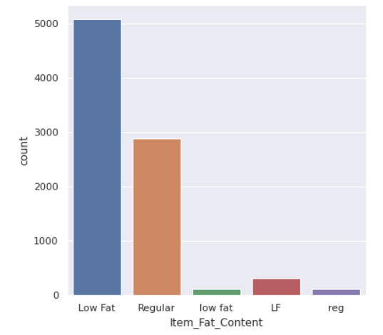
Numerical Features
Categorical Features

Slide 9
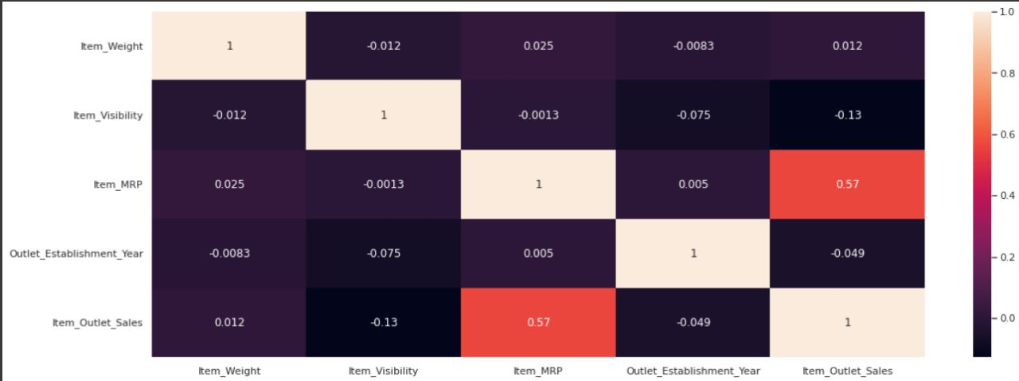
Heatmap
Heatmap represents coefficients to visualize the strength of correlation among variables

Slide 10
Related Work And Literature Survey
s.no | Author | Title | Conclusion
1 | Ragg and Augusto Ribeiro | pharmaceutical distribution on company's sale forecast | A Forecast for Big Mart Sales Based on Random Forests and Multiple Linear Regression used Random Forest and Linear Regression for prediction analysis which gives less accuracy. To overcome this we can use XG boost Algorithm which will give more accuracy and will be more efficient
2 | Armstrong J | forecast sales using hive, R programing , tableau. | By looking at the store's past, you may have a better knowledge of the income and make changes to the objective to make it more successful. To achieve the findings, key values are retrieved inside the diagram to decrease all intermediate values by lowering the intermediate key feature.
3 | Manpreet Singh | Inspection of data obtained from a retail store | The impacts of numerous sequences of events, such as meteorological conditions, vacations, and so on, may genuinely change the status of various departments, therefore it also analyses and evaluates these effects and their impact on sales.
4 | Demchenko | forecast sales using generic linear method, a decision tree approach, and a decent gradient approach | The original data set evaluated included a large number of entries, but the final data set utilized for analysis was significantly less than the original since it included non-usable data, duplicate entries, and unimportant sales data.

Slide 11
PROPOSED WORK
Initially, we will select dataset(Big mart sales prediction) for performing machine learning on it.
In starting the data set will be dirty so we will firstly do preprocessing on it so that we can apply various algorithms for machine learning
This preprocessing will begin with data cleaning where we fill the missing values of given features, remove outliers from the data, dimensionality reduction, etc. Where dimensionality reduction can be divided into feature selection and feature extraction.
Then we will perform feature scaling where we will normalize the given data values to the range of 0-1

Slide 12
PROPOSED
WORK
The obtained dataset will be divided into two parts of train dataset and test dataset using train-test split.
After that ,we will start creating the linear regression model and we will feed train dataset for model training and test dataset for model evaluation.
Then we will implement different algorithms XGBoost regressor, random forest Regressor .

Slide 13
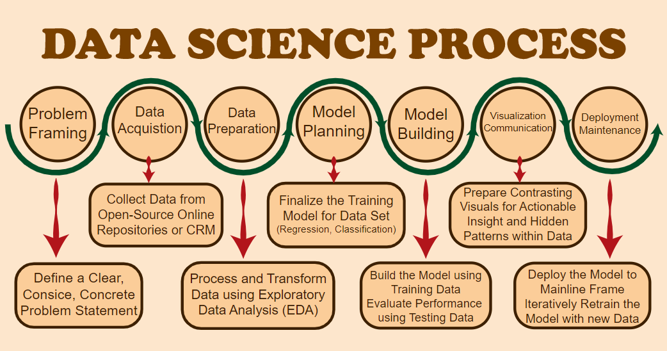

Slide 14
CONCLUSION
We have developed a model in which by giving some information of certain parameters it will predict sales of that item.
The prediction results show the correlation among different attributes considered and how a particular location of medium size recorded the highest sales, suggesting that other shopping locations should follow similar patterns for improved sales.
One of the main highlights is more expressive regression outputs, which are more understandable bounded with some of accuracy.

Slide 15
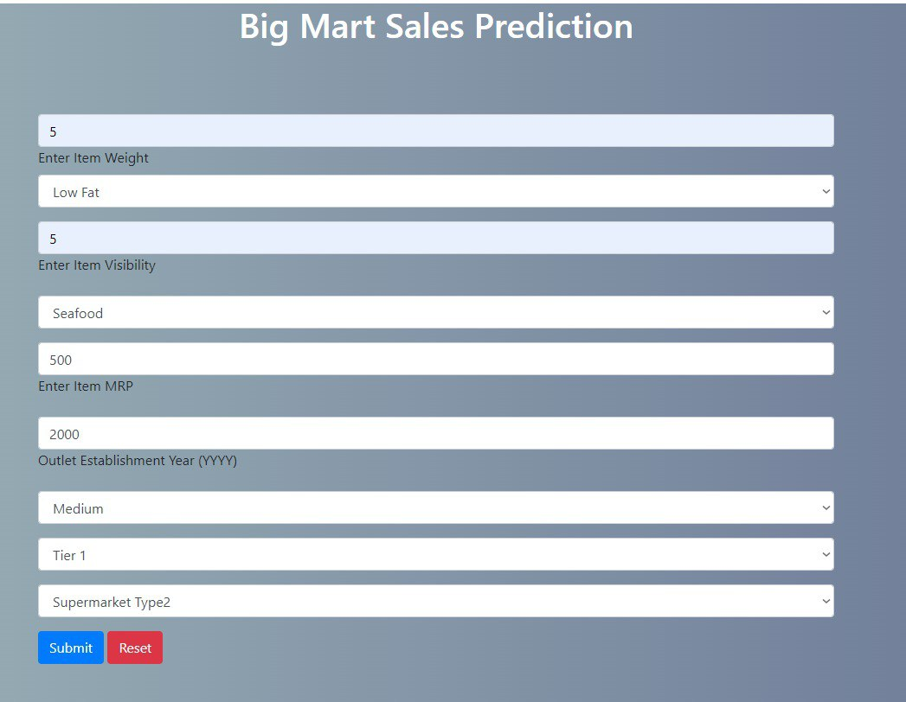

Input
Output

Slide 16
References
https://www.kaggle.com/brijbhushannan...
https://youtu.be/W9p7B0HR820
https://youtu.be/kgjZAHCTGNI
https://ijcrt.org/papers/IJCRT2106802.pdf
https://github.com/pydeveloperashish/BigMart-Sales-Prediction-With-Deployment

Slide 17
THANK YOU

